Slide 1

Amazon Review Prediction
Name: Mohanad Mohamed Abdel Rahman.
Id: 182327.
Supervised by: Dr. Nermine othman.

Slide 2


Introduction
01
Word of mouth is the most effective way to advertise a product as it is free and so powerful to attract consumers on Amazon to buy or not to buy the product.
The lack or absence of reviews make the customer feel risk and unwillingly to buy the product.
Approximately 86% of the consumers on Amazon totally depend on the reviews of the product before making the purchase to guarantee the goodness of product.

Slide 3
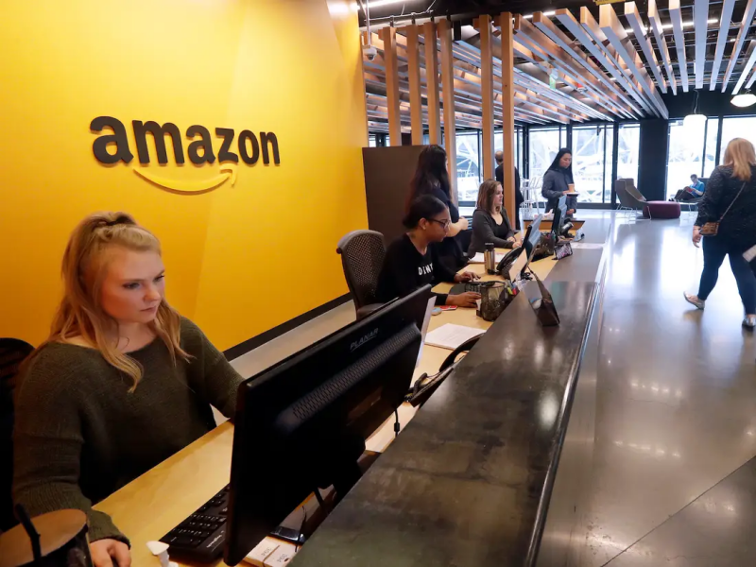
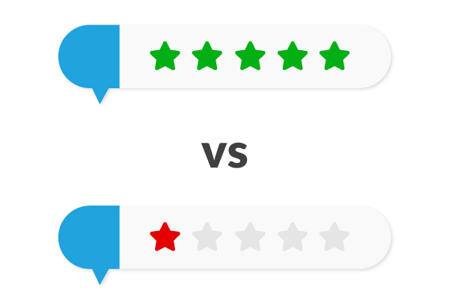
Introduction
01
Amazon employees make knowledge of the product depending on the reviews of the consumers.
Negative reviews make amazon employees notice and warn the supplier to fix the problem that face consumers and if it continues will lead to cutting the selling of product.
Positive reviews make amazon employees give credit and increase cooperation with supplier leading to put the product as best seller or best reviewed.

Slide 4


Problem
02
Consumers face daily issues concerning the reviews of a certain product as the reviews could be a lot to observe and can’t reach the average reviews on the product.
Amazon employees have a difficulty to read all reviews of the product as it’s time consuming .
The stars review sometimes could not be accurate as maybe the text review give a goodness of fit for the product but the star review doesn’t fit with the text.

Slide 5
Literature Review:
“A Brief Analysis of Amazon Online Reviews” 2019:
this paper emphasizes on how user votes are important as they use them as a source information for new users. Using SVM model of accuracy 80%
“Success Prediction using Random Forest, CatBoost, XGBoost and AdaBoost for Kickstarter Campaigns” 2019:
This paper used Random Forest of accuracy 79.97%, Random Forest with AdaBoost of accuracy 80.51%, XGBoost Classifier of acuuracy 70.79%, CatBoost with accuracy of 83.33%.
“A Review of Stock Market Prediction with Artificial Neural Network (ANN)” 2013:
This paper used ANN Model of accuracy 96.7%.
Accordingly to these papers I noticed that these models must have big data to increase the accuracy that’s why I used ANN with big data (deep learning).

Slide 6
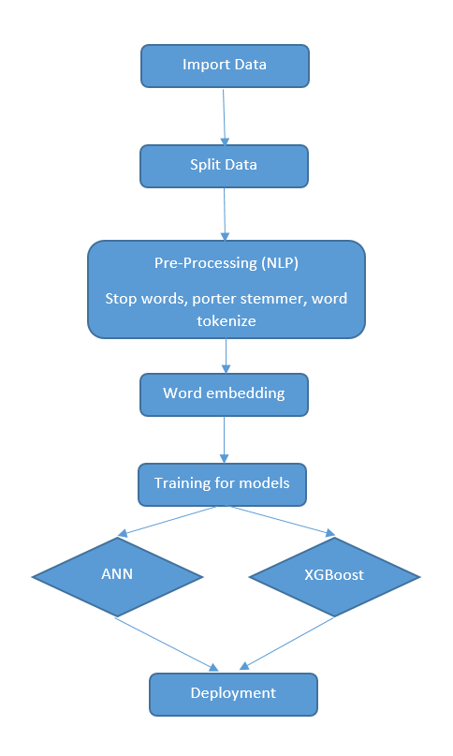
Proposed solution
3

Slide 7
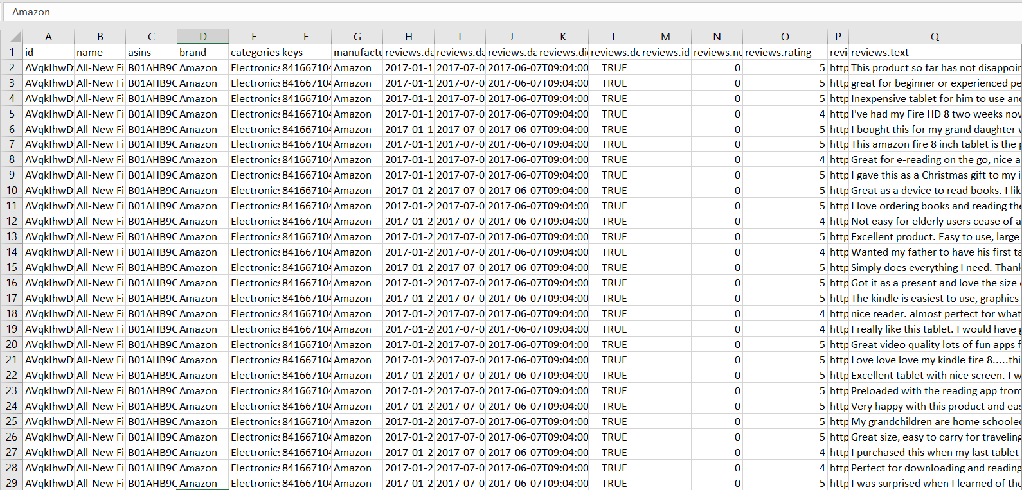
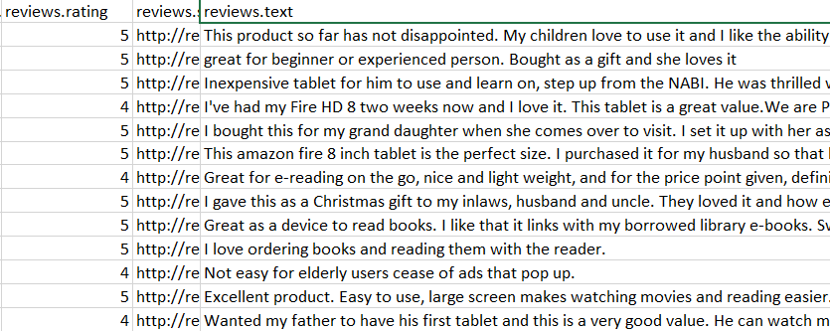
Dataset
4
The dataset consists of 34,661 for previous reviews of different products on Amazon.
The dataset was gathered from 2010 to 2017 from reviews made on various products.
The dataset is gathered from different reviews and from different products with their ratings.

Slide 8
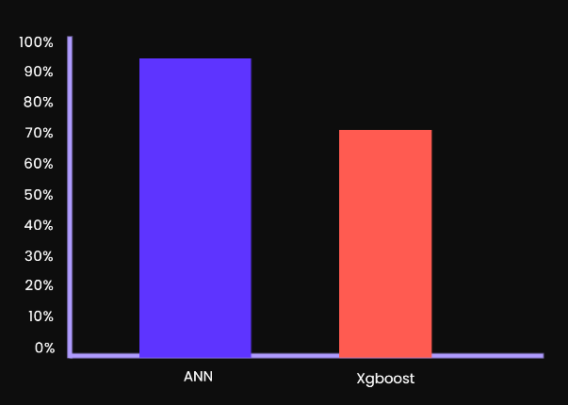
Algorithms
5
Xgboost
The whole idea is to correct the previous mistake done by the model, learn from it and its next step improves the performance.
Artificial Neural Network (ANN)
Artificial neural networks have the ability to provide the data to be processed in parallel.
It is Highly Flexible
We are able to train ANN’s that these networks learn from past events and make decisions.
It is designed to handle missing data with its in-build features.

Slide 9
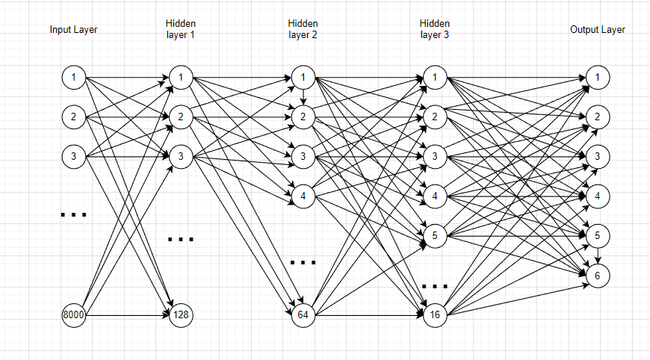
ANN
ANN will first detect the text from the column of (Reviews.text)
input layer contains 8000 neurons
There is 3 hidden layers
Output Layer contains review rating scale (0 to 5)
6
.

Slide 10
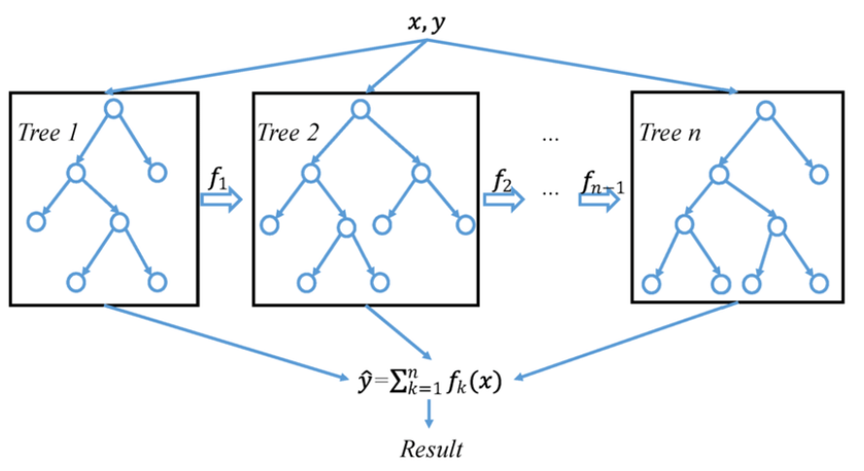
Xgboost Algorithm
8
this model is used to divide the data set into trees, every tree will take 90% of the data randomly, then every tree is going to train on the random data that it will cover, and will give certain accuracy according to how the model tried to learn, and will give error percentage, then the next tree will take another random part of the data set and will learn from the previous tree and try to reduce the percentage of the error which will lead in improving the accuracy, until reaching the last tree that will give the best accuracy with the minimum error percentage.

Slide 11


Experiments and Results
10
As shown in the first figure the Xgboost model gives accuracy of 71.12
The other figure shown that the ANN Model gives accuracy of 98.59%

Slide 12
Conclusion
11
PROBLEM
- The system will detect the text consumer type according to previous data set that the model have learned therefore generate accurate review rating.
- Detecting the review that the consumer will text and converted to degree scale from 0 to 5.
Consumers get distracted from the reviews and can’t reach the average reviews on the product. Amazon employees have a difficulty to read all reviews of the product as it’s time consuming. the star review accuracy may not fit with the text.
Solution

Slide 13
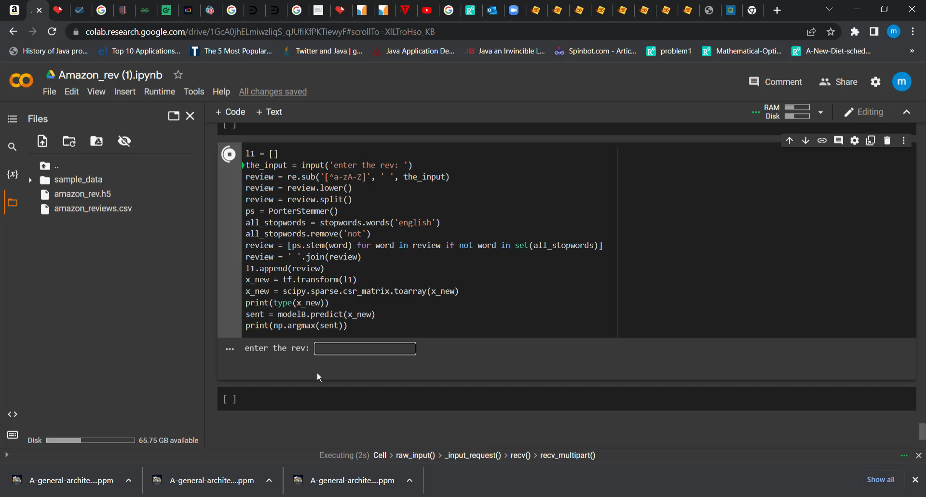

Slide 14

1

